Slide 1


NEXT GEN EMPLOYABILITY PROGRAM
CREATING A FUTURE-READY WORKFORCE
Student Name :
Rohith Cheruku
Student ID :
College Name :
STU645e4ad8d57b31683901144
SR University

Slide 2
CAPSTONE PROJECT SHOWCASE
WORK IN
Abstract | Problem Statement | Project Overview | Proposed Solution | Technology Used | Modelling & Results | Conclusion | Q&A

Slide 3
Abstract
1
Innovative job portal application revolutionizing the recruitment process by seamlessly connecting employers and job seekers through a user-friendly interface.
2
Leveraging advanced algorithms and machine learning to match candidates with suitable job opportunities based on their skills, experience, and preferences.
3
Offering a comprehensive platform that streamlines the hiring process for employers, from posting job listings to managing applications and conducting interviews.
4
Empowering job seekers with personalized recommendations, career guidance, and resources to enhance their professional journey and achieve their career goals.

Slide 4


Problem Statement
The current landscape of job search platforms lacks a cohesive and efficient solution for both job seekers and employers, resulting in a fragmented and often frustrating experience. Existing platforms are either overly complex and cumbersome to navigate, or lack the sophisticated algorithms necessary to effectively match candidates with suitable job opportunities. Moreover, many platforms lack the necessary features for streamlined communication and collaboration between employers and applicants, leading to inefficiencies and delays in the hiring process. These challenges highlight the urgent need for a comprehensive job portal application built on Django, offering a user-friendly interface, advanced matching algorithms, and robust communication tools to seamlessly connect employers with qualified candidates and optimize the recruitment process for all stakeholders.

Slide 5

Project Overview
The job portal application built on Django is a comprehensive platform designed to revolutionize the recruitment process for both employers and job seekers. Leveraging the power of Django, the application provides a robust and scalable solution that offers a seamless user experience and advanced functionality. For job seekers, the platform offers personalized job recommendations, streamlined job search capabilities, and tools for enhancing their professional profiles. Employers benefit from features such as job posting management, applicant tracking, and integrated communication tools to facilitate efficient hiring processes. With its intuitive interface, powerful matching algorithms, and extensive feature set, the job portal application aims to optimize the recruitment process, saving time and resources for both employers and job seekers alike.

Slide 6
Proposed Solution
The proposed solution for the job portal application utilizing Django entails developing a robust and user-centric platform that seamlessly connects job seekers with employers, streamlining the entire recruitment process. Employing Django's powerful framework, the application will incorporate advanced algorithms for efficient job matching based on candidate skills and preferences. It will feature a user-friendly interface for easy navigation, allowing job seekers to create comprehensive profiles, search for relevant opportunities, and receive personalized job recommendations. For employers, the platform will offer intuitive job posting and management tools, applicant tracking functionalities, and integrated communication channels to facilitate seamless interaction with potential hires. Additionally, the application will prioritize scalability and security to accommodate future growth and ensure data protection. Through the utilization of Django's capabilities, the proposed solution aims to revolutionize the job search experience, providing a comprehensive and efficient solution for both job seekers and employers.

Slide 7
Technology used
For the job portal application built on Django, several technologies can be utilized to ensure its robustness, scalability, and efficiency:
Django Framework
Database Management System (DBMS)
Frontend Technologies: HTML, CSS, and JavaScript
By leveraging these technologies in conjunction with Django's capabilities, the job portal application can be developed to offer a robust, scalable, and efficient solution for connecting job seekers with employers while ensuring a seamless user experience.

Slide 8
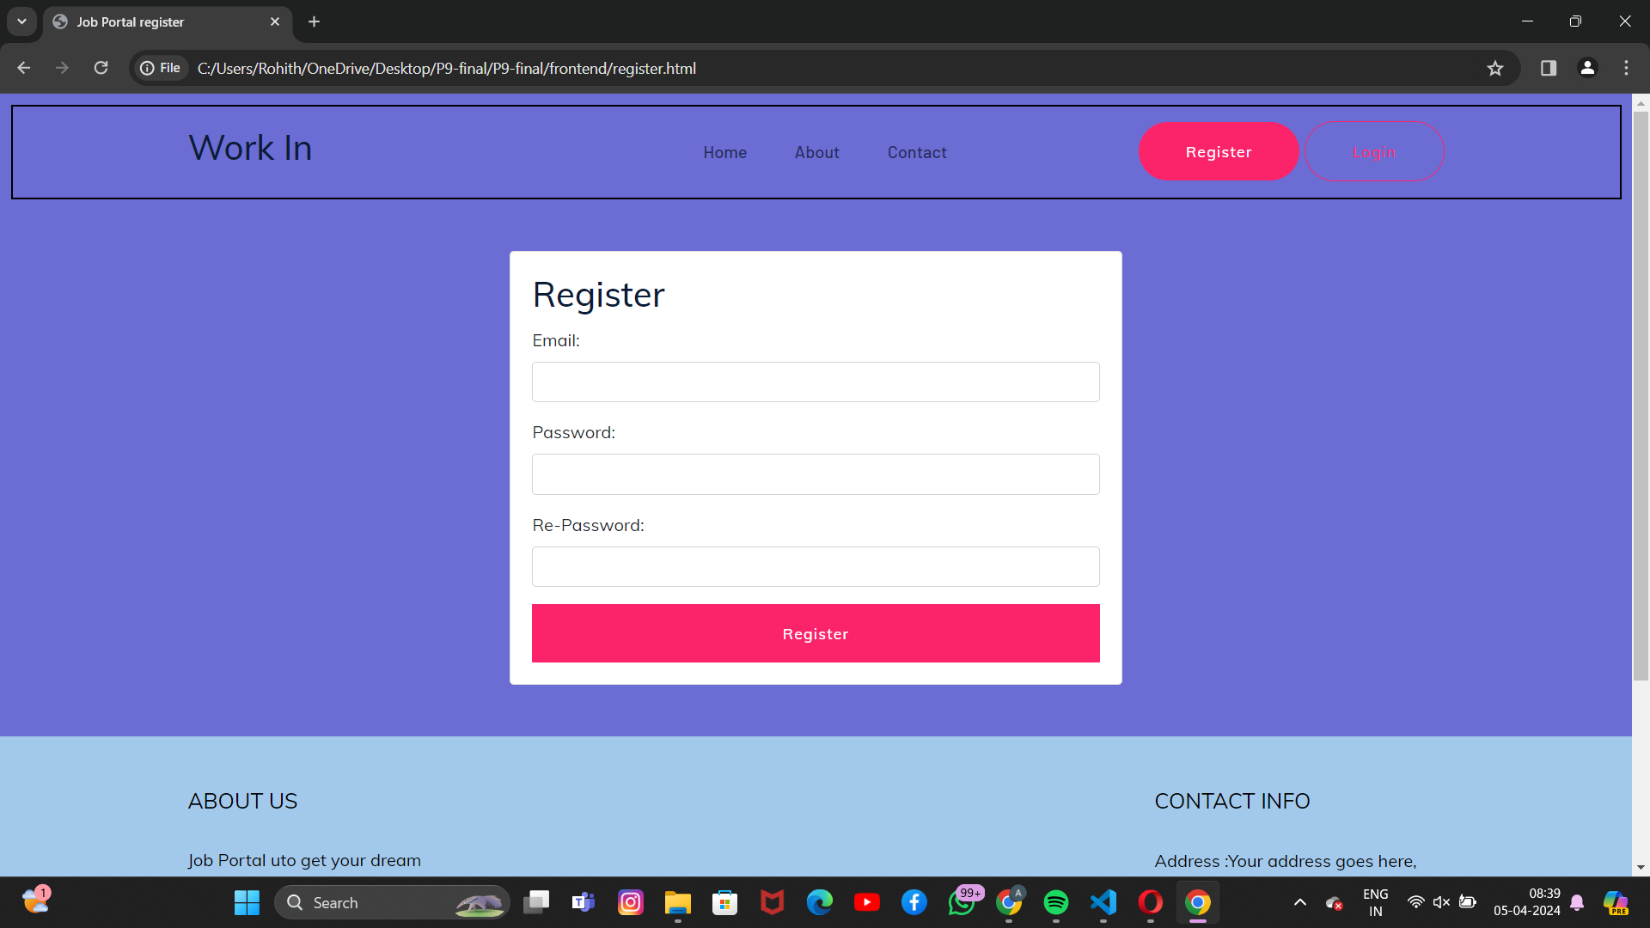
Modelling & Result

Slide 9
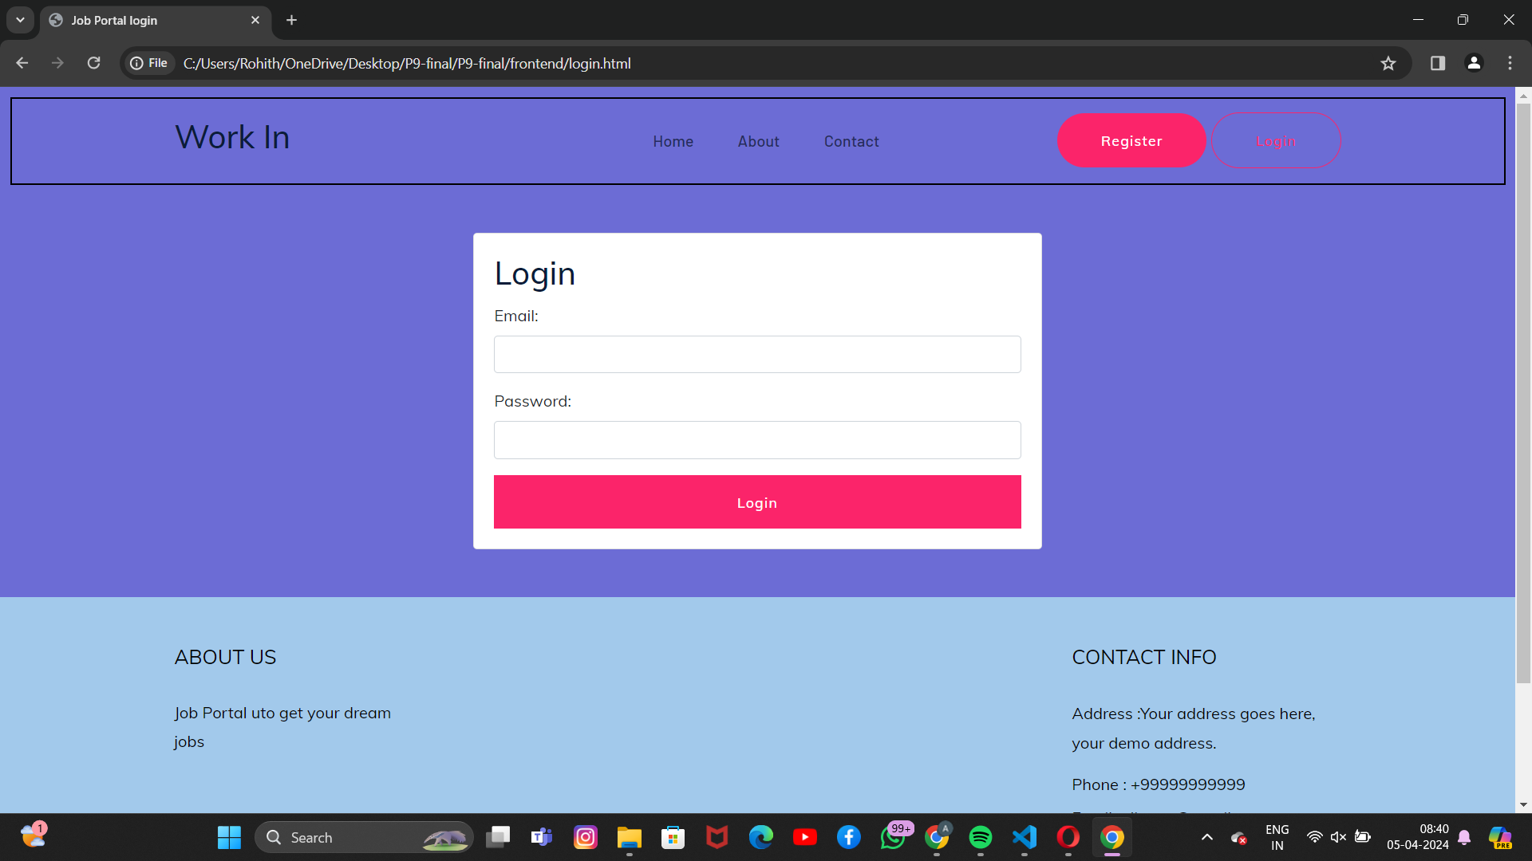
Modelling & Result

Slide 10
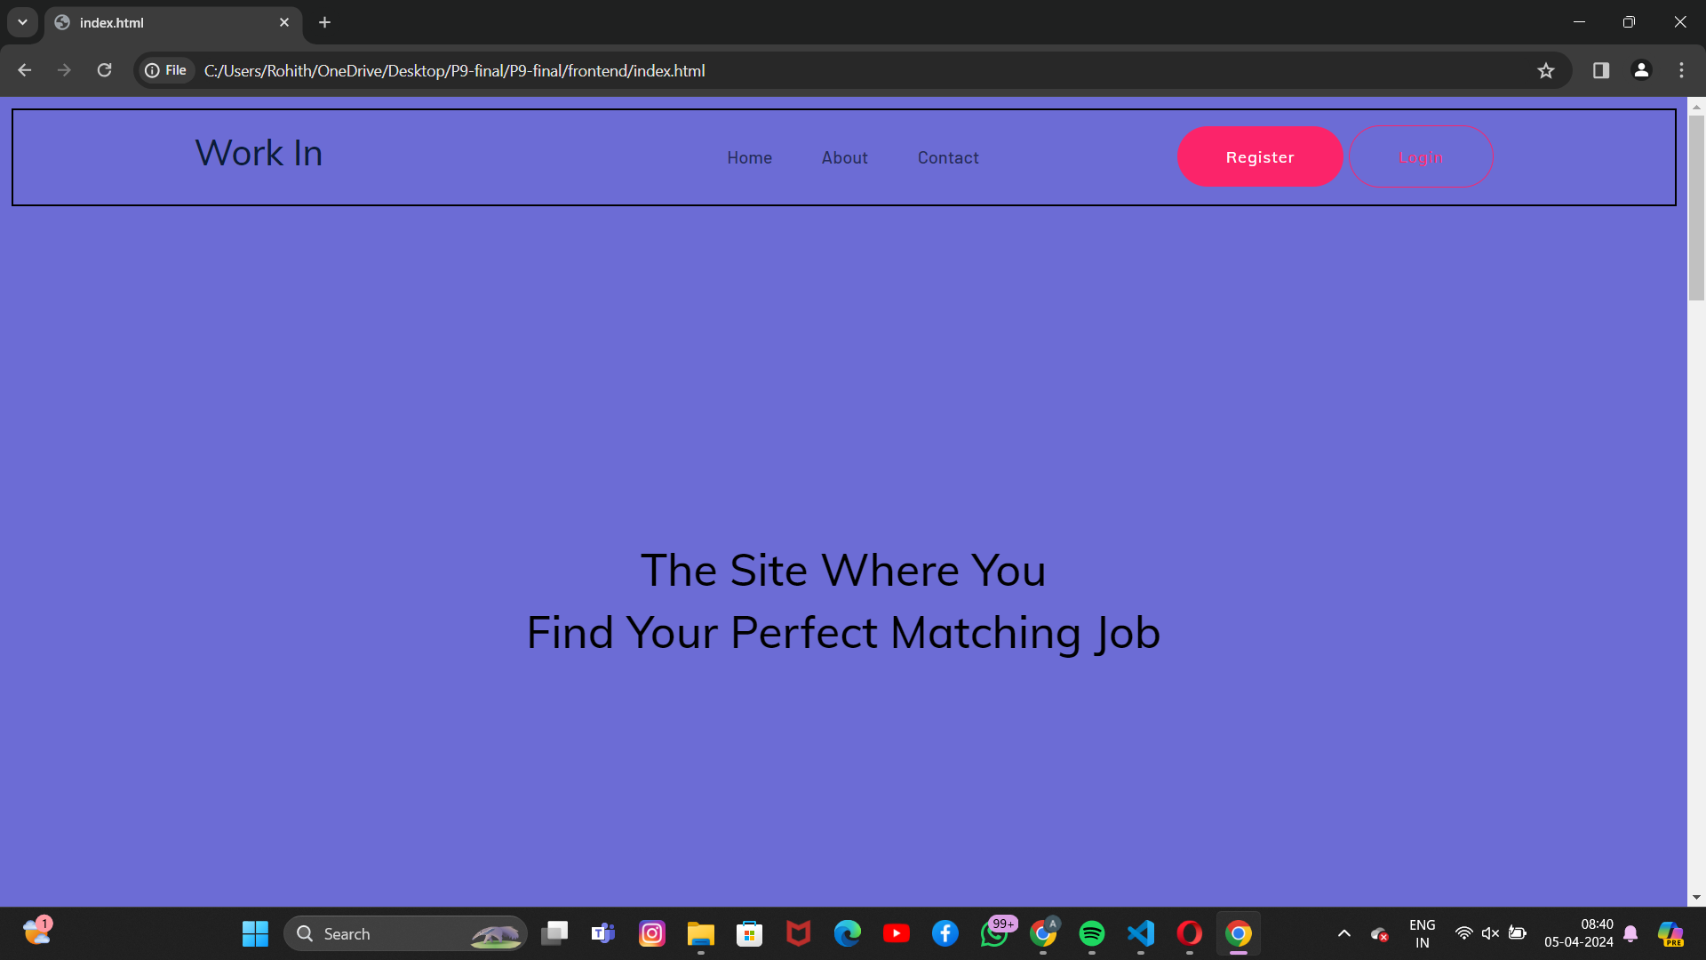
Modelling & Result

Slide 11
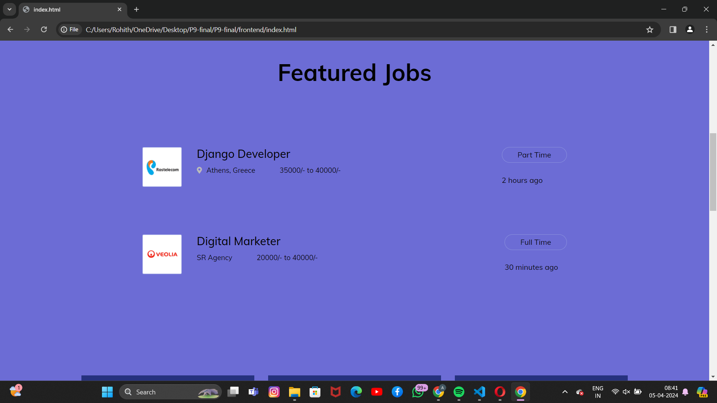
Modelling & Result

Slide 12
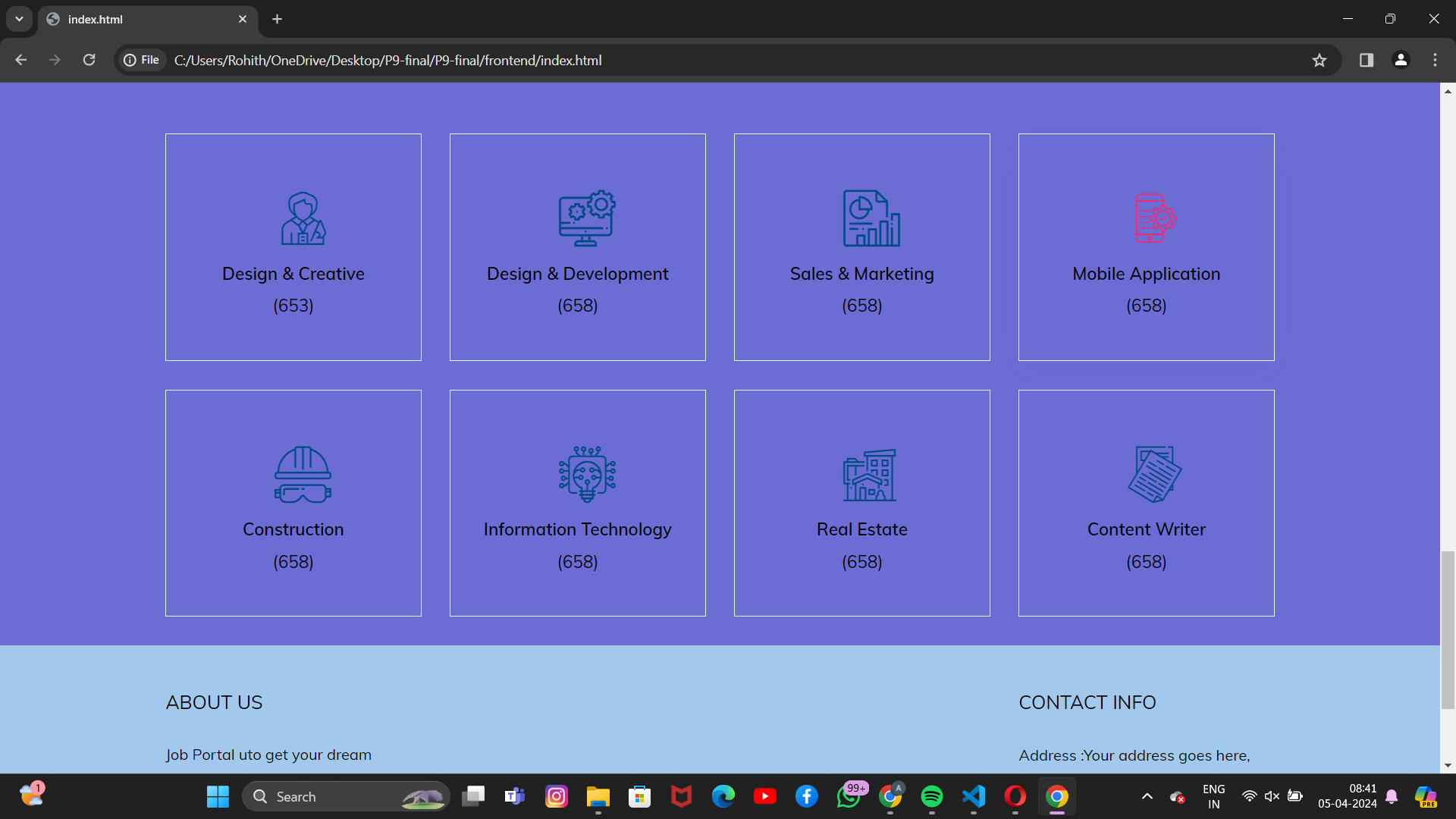
Modelling & Result

Slide 13
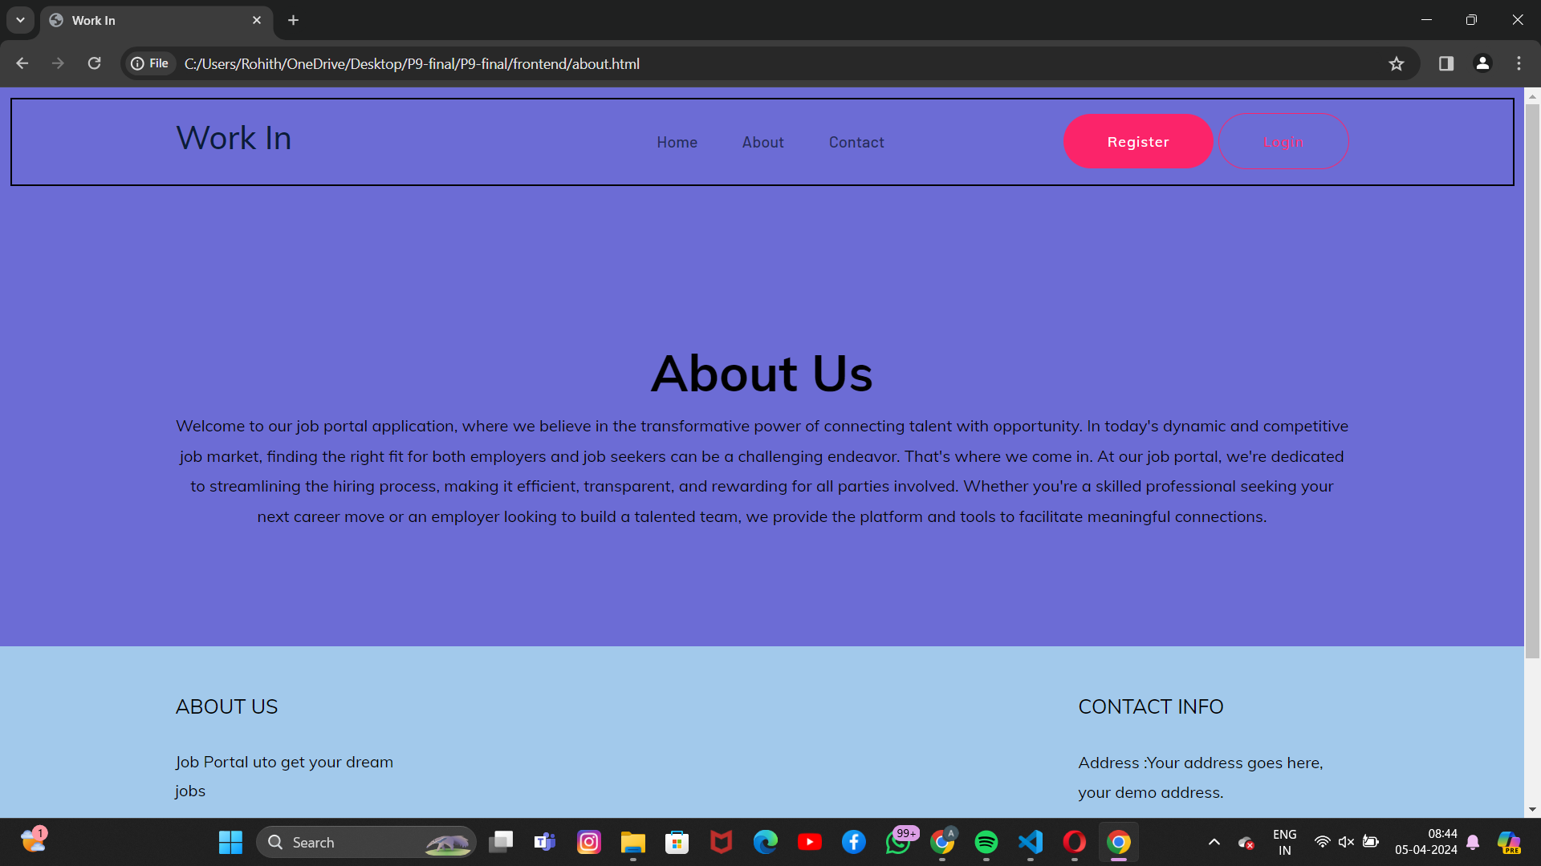
Modelling & Result

Slide 14
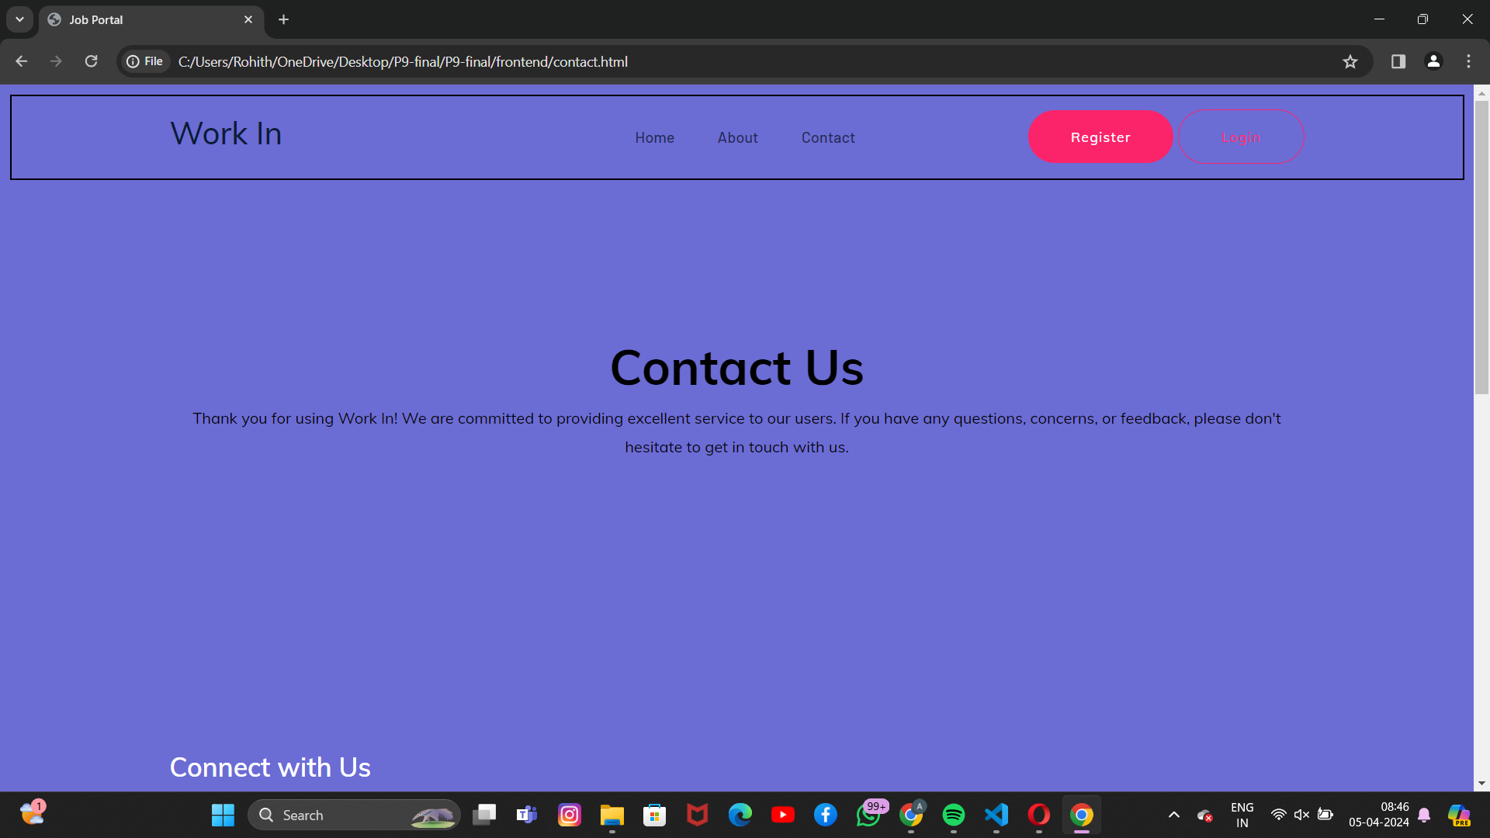
Modelling & Result

Slide 15
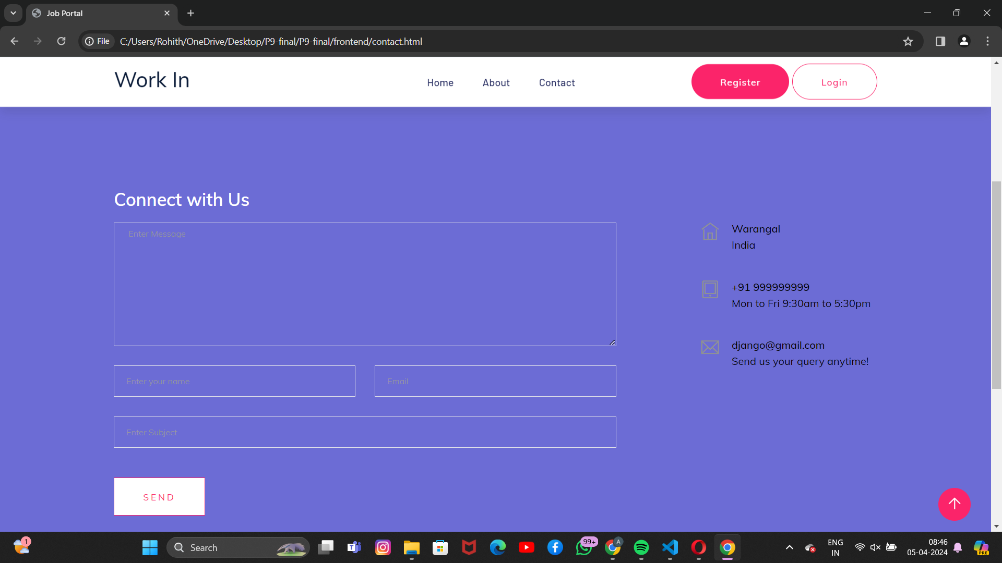
Modelling & Result

Slide 16

Conclusion
In conclusion, the utilization of Django as the core framework for the development of the job portal application offers a myriad of advantages, from its rapid development capabilities to its robust security features. By harnessing Django's powerful tools and integrations, we can create a user-centric platform that seamlessly connects job seekers with employers, optimizing the recruitment process for both parties. Through intuitive interfaces, advanced algorithms for job matching, and efficient communication channels, the application aims to revolutionize the job search experience, saving time and resources while enhancing the likelihood of successful matches. With scalability, reliability, and security at its core, the job portal application built on Django stands poised to make significant strides in improving the efficiency and effectiveness of the job market ecosystem.

Slide 17


Notes:
Thank You !!

